Slide 1

Computer Engineering Department A.P. Shah Institute of Technology G.B.Road,Kasarvadavli, Thane(W), Mumbai-400615 UNIVERSITY OF MUMBAI Academic Year 2021-2022

Slide 2
Synopsis on Hospital Database System Submitted in partial fulfillment of the degree of Bachelor of Engineering(Sem-3) in Computer Engineering By 71_Atharva Ajit karekar (20102117) 60_Bhavesh Shantilal Jain(20102120) 83_Sahil Mahesh Limaye (20102115)
54_Shreyash Rajesh Gupta(20102124) Under the Guidance of Prof. Amol Kalugade

Slide 3
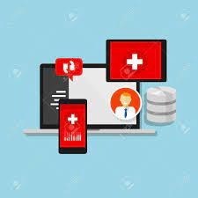
Abstract
HMS is useful for record the details of the patients.
Through connection between user terminal and service,both patient and doctor are able to obtain required data to achieve a better interaction
It has two levels –
Admin level
User level
In admin level there are two members. They are doctor and bill counter admin.
The user level is having the patient .
Patient can easily know about the health status and can easily navigate to the hospital.
Image Source:Dataimage.com

Slide 4
1.1 Problem Definition
A theoretical study of the problem and how to solve it Problems with conventional system
This results in inconvenience and wastage of time.
Error prone manual calculation: - Manual calculations are error prone and take a lot of time this may result in incorrect information.
For example: calculation of patient's bill based on various treatments.
Preparation of accurate and prompt reports: - This becomes a difficult task as information is difficult to collect from various registers.

Slide 5
1.2 Objectives
The objective of this project is to develop hospital management software based on Microsoft window application with structured Query language (T-SQL and SQL Server as a database) as the back-end database hospital from file based system to a computer database system.
It also is very inefficient and a time-consuming process Observing the continuous increase in population and number of people visiting the hospital.Recording and maintaining all these records is highly unreliable, inefficient and error-prone.
Thus keeping the working of the manual system as the basis of our project.
We have developed an automated version of the manual system, named as "Administration support system for medical .institutions The main aim of our project is to provide a paper-less hospital up to 90%.

Slide 6

1.3 Scope
The Current system in use is a paper-based system,it is too slow and cannot provide updated list of patients within a reasonable timeframe.
The intension of HMS system is to reduce over time pay and increase the number of patients that can be treated accurately.
The HMS can be used in any Hospital,clinic,pathology labs to get the information from the patients and then storing the data for future usage.
Image source:dataimage.com

Slide 7

1.4 Existing System/project
As doctor provides a handwritten prescription and this prescription are difficult to preserve
It may be difficult for Doctor as well a patient to maintain
this written records.
These processes prevent the patient and physicians from remembering the previous treatment.
mage source:www.freepik.com

Slide 8
2 Technology stack
For FRONT-END
Use of LANGUAGE are as Follows :
CSS
HTML
For BACK-END
Use of LANGUAGE are as follows :
JAVASCRIPT
MY SQL ( FOR DATABASE)
Java server pages (JSP)
Image source : Microsoft clipart

Slide 9

3.1 Benefits for environment
Database system in medicine: The linked database is the most used in the health sector.
Specific databases with silent resistance can be used to determine the primary symptoms of these drugs and the patient's current condition, such as blood flow, pulse, and blood sugar.
For example, the database associated with the cardiac unit can be linked directly to the recruitment media.
It needs to be changed so that cardiologists can enter free information into the database and highlight the best patient care.
Image Source:www.coverstory.com

Slide 10

3.2 Benefits for Society
Improved Diagnosis and Treatment The primary benefit of a smart hospital management system is that it improves patient diagnosis and treatment.
The patient's health report and medical history from the past to the present, as well as the illness he is suffering from and the care he received, can all be added to and accessed via the HMS.
Using this knowledge, doctors can better assess patients' health problems, ultimately empowering them to provide the best care possible.
Image source:www.freepik.com

Slide 11
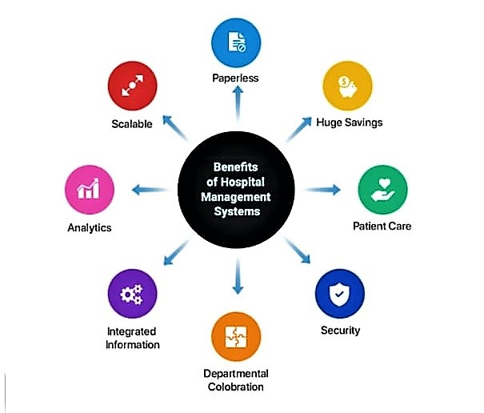
3.2 Benefits for Society Image source :(softwaresuggest.com)

Slide 12

3.3 Applications
Appointment Management
Billing Management
Prescription Management
Discharge Summary
Operation Theatre Management
Pharmacy Management
Lab Management
Master Information System
Manage Multiple Locations
Image Source:https://media.istockphoto.com/

Slide 13

4.Project Design
APSIT MEDLIFE HOSPITAL
Login Page :
login as a doctor
login as a patient
For Doctors - There will be a list of doctor name in the login id place and password will be -BIRTH DATE
For patient – The Login Id will be -AADHAAR CARD
Number and Passwoed will be - BIRTH DATE

Slide 14
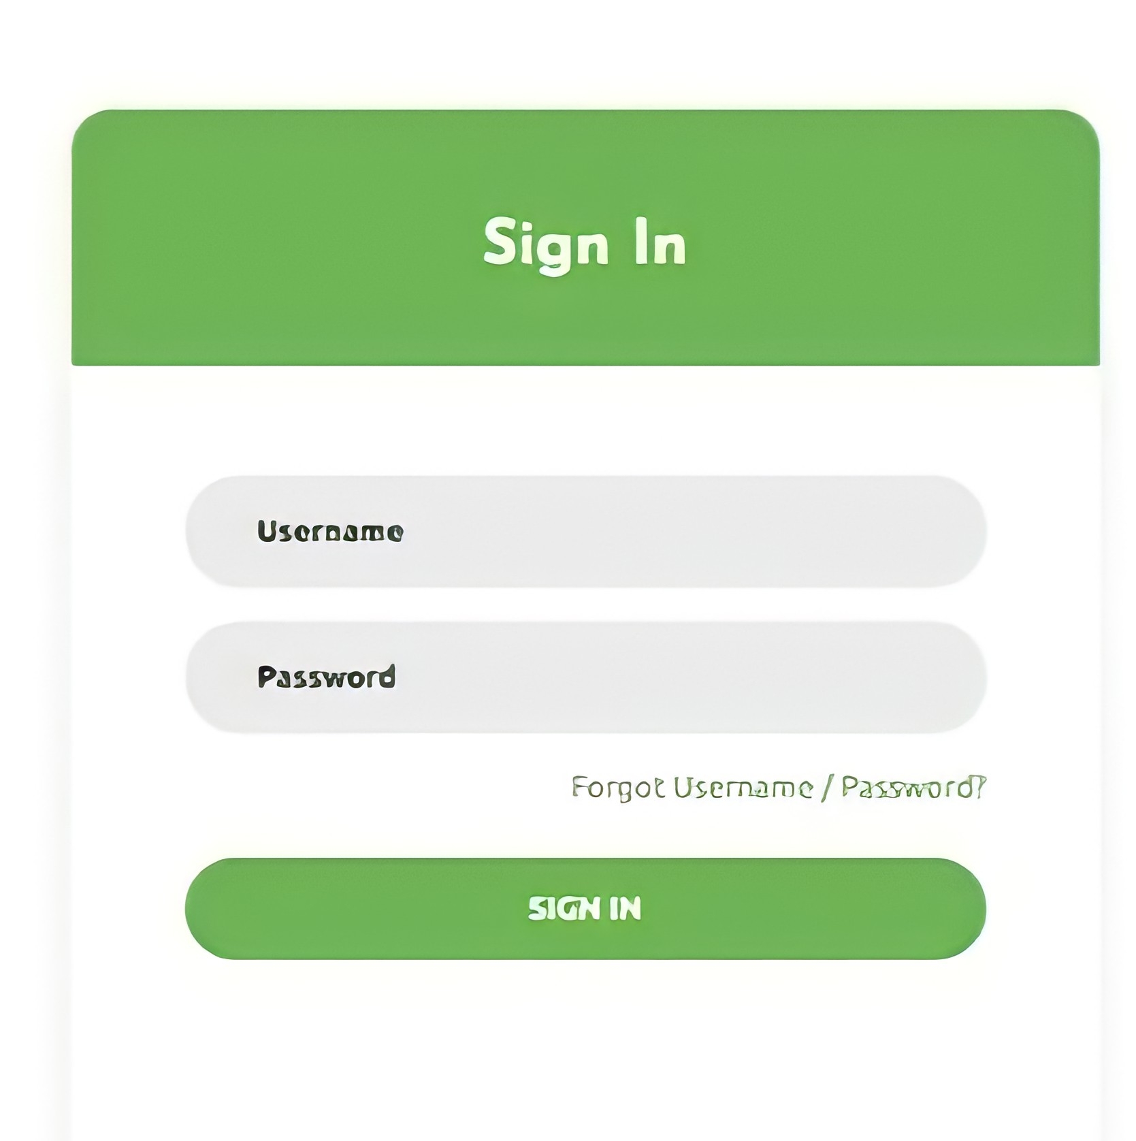

Slide 15
4.Project Design
For doctors
After logging.
He/She will be able to see the name of the patients they had treated .
They can watch the recovery status of patients
For Patients
After logging
Doctor Which Was consulted
What ailments he/she was dealing with.
A tab will indicate the list of physicians and their specialty.
Prescription History

Slide 16
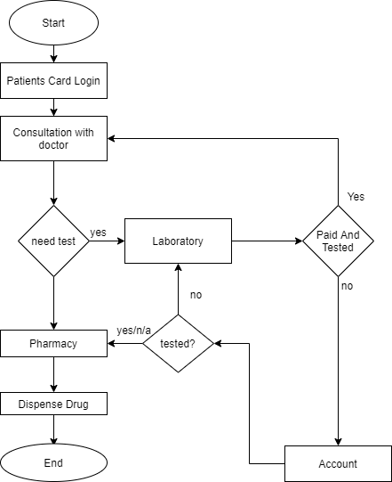

4.2 Algorithm Image Source:www.istocks.com

Slide 17
Thank You

